Slide 1
Trustless API
Reza Motevallizadeh

Slide 2
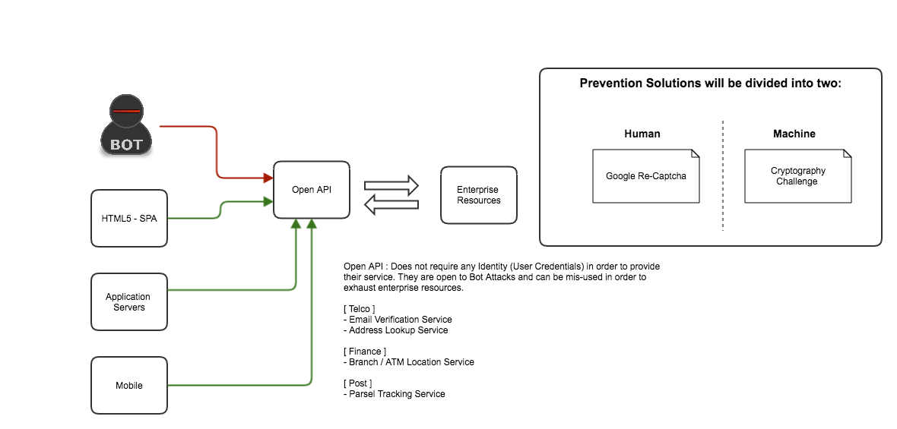
Problem
Alternative
API Key is an Identification and can’t secure your APIs
API Key and Secret on Client side is also not secure

Slide 3
Solutions
Most of them a preventions and not blocking
reCAPTCHA: Easy on Humans, Hard on Bots ?
Proof of Work: Trustless, Lets Machines fights

Slide 4
Google reCAPTCHA
https://developers.google.com/recaptcha/

Slide 5
Crypto - Challenge

Slide 6
Pros and Cons
Google Re-Captcha
Crypto-Challenge
Specifically designed for web
Required Human Interaction with
One way to go as specified by the Vendor
Implementation
SaaS : Only implementation by the Vendor (e.g. Google)
Integration
As its known technology and easy to integrate (of course UI changes involves)
Common and generic
Client and Server interact with each other
Can be adjusted based on business requirement and Flexible
Proven work in Trustless environment (Email Spam filtering, Bot Detection, Blockchain)
Implementation
SaaS solution is available (hashcash.io , kasada.io)
Can be developed and implemented by internally
Integration
Its new and complex to some level, needs more understanding but integration is transparent form user and UI

Slide 7
Crypto – Challenge D.L.
Notes:
title Bot Prevention - Hashcash - Proof-of-Workparticipant Client (SPA, Mobile, App Server) as clientparticipant Secure Token Service(STS) as Lambdaclient->Lambda: Requests for OTT(One Time Token)Lambda -> redis: Checks Redis cache for client's IPLambda -> Lambda: Checks for x-hashcash and x-hashcash-solutionLambda -> Lambda: Creates a new signed crypto challengenote left of Lambda rnd-challenge:time(hex):IP:API-Resource:Complexity:No-of-Attemp:HMACSHA256e.g.18888127f:15f206eb0ab:10.10.10.10:/api/verifyemail:4:1:3590316bef05ba9707d43eea51de676d1652853dend noteLambda -> redis: Updates Redis CacheLambda -> client: Sends crypto challenge via x-hashcash header to client (HTTP 403) client -> client: Starts to find the nounce (solution) with Complexity provided by Lambdaclient -> Lambda: Sends both x-hashcash and x-hashcash-solution to LambdaLambda -> Lambda: Validates clients nounceLambda -> Lambda: Creates a OTT - JWT Token (includes x-hashcash, x-hashcash-solution, resource, TTL)note left of Lambda JWT Token structure:{ "x-hashcash": "rnd-challenge:time(hex):IP:API-Resource:Complexity:No-of-Attemp:HMACSHA256", "x-hashcash-response": "34234293824", "resource": "/api/verifyemail", "ttl":"Time-To-Live-in-milli-sec"}end noteLambda -> redis: Stores x-hashcash verification results in cache against client's IPnote left of Lambda- Any attempt to obtain token before expiry the successfull challenge will be punished by higher complexity - After certain number of failure attemp from specific client, the complexity will be increasedend noteLambda -> client: Sends the OTT - JWT Access Token to Client (HTTP 200)client -> client: Uses OTT - JWT access Token to access the protected resource

Slide 8
References
Hashcash.io (https://hashcash.io/)
Google Re-Captcha
http://deathbycaptcha.com

